Slide 1
Works
1
Group learning method for third biomarker prediction
2
Generative AI competition

Slide 2
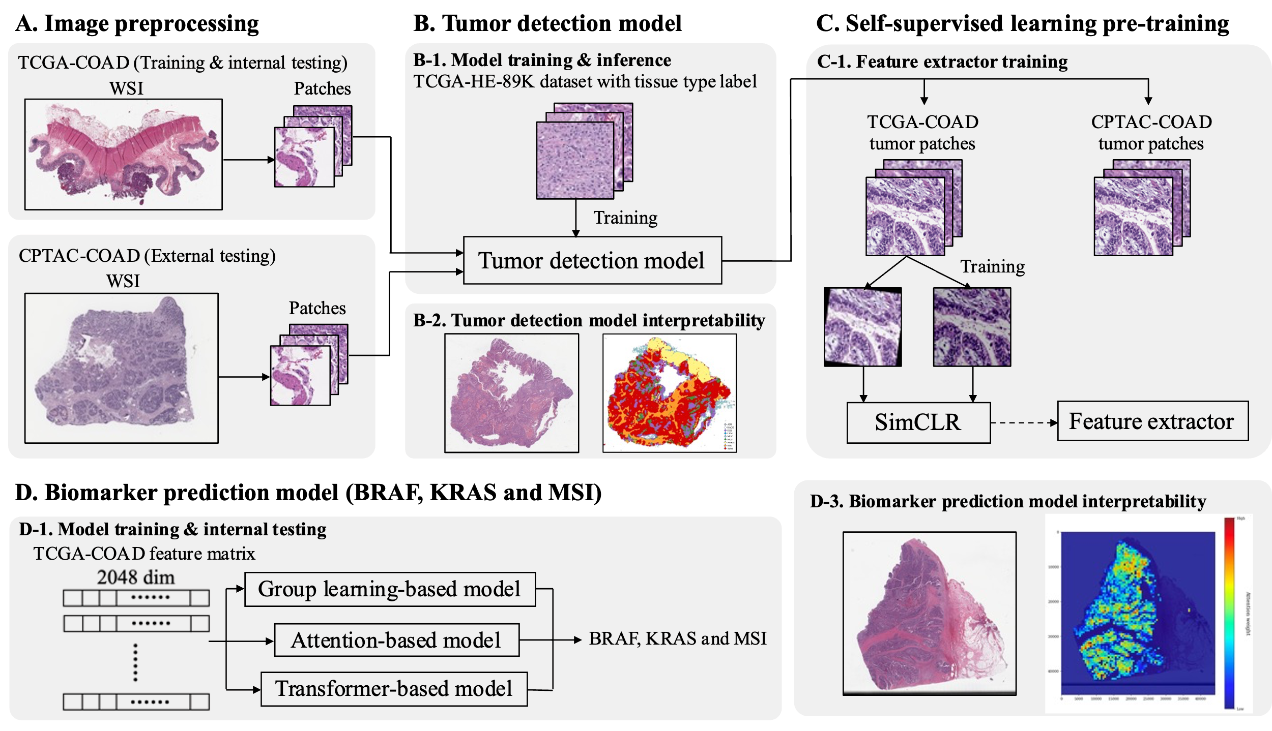

Slide 3
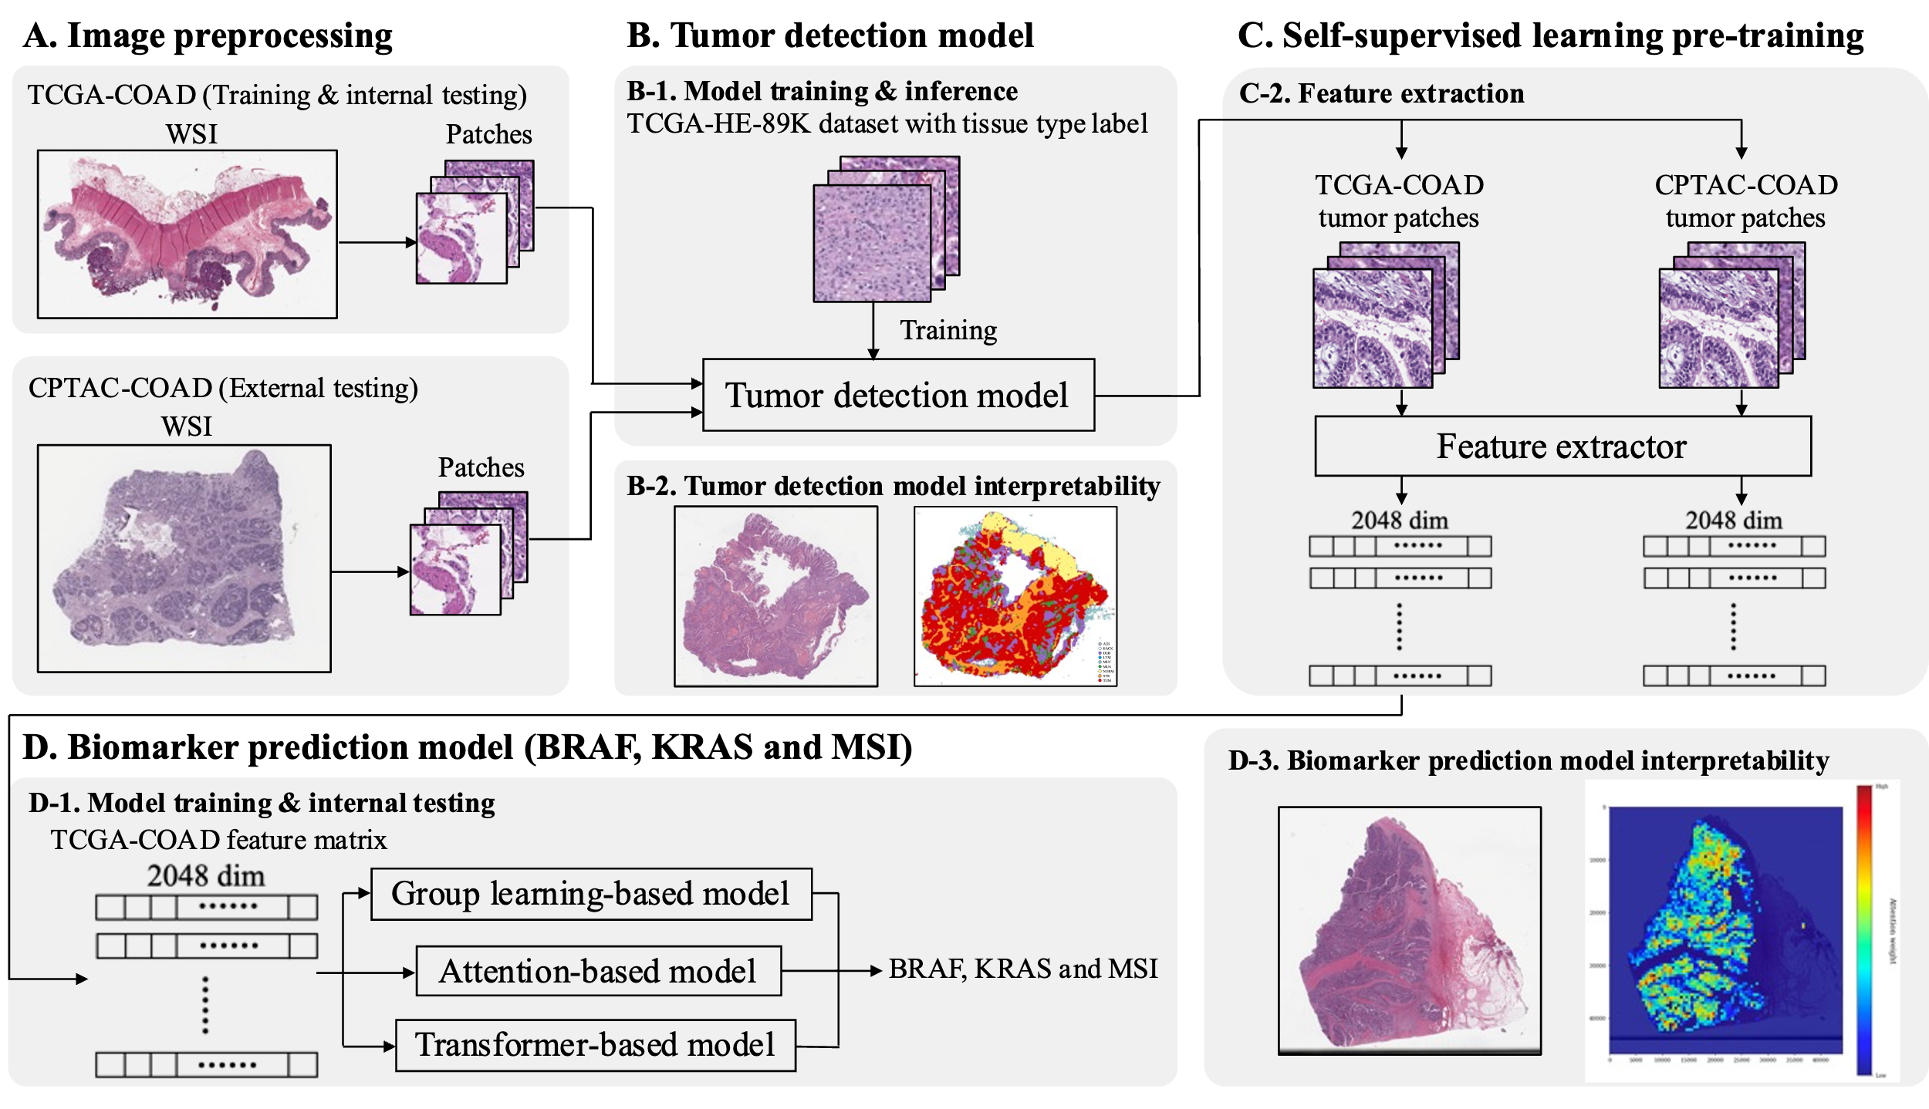

Slide 4
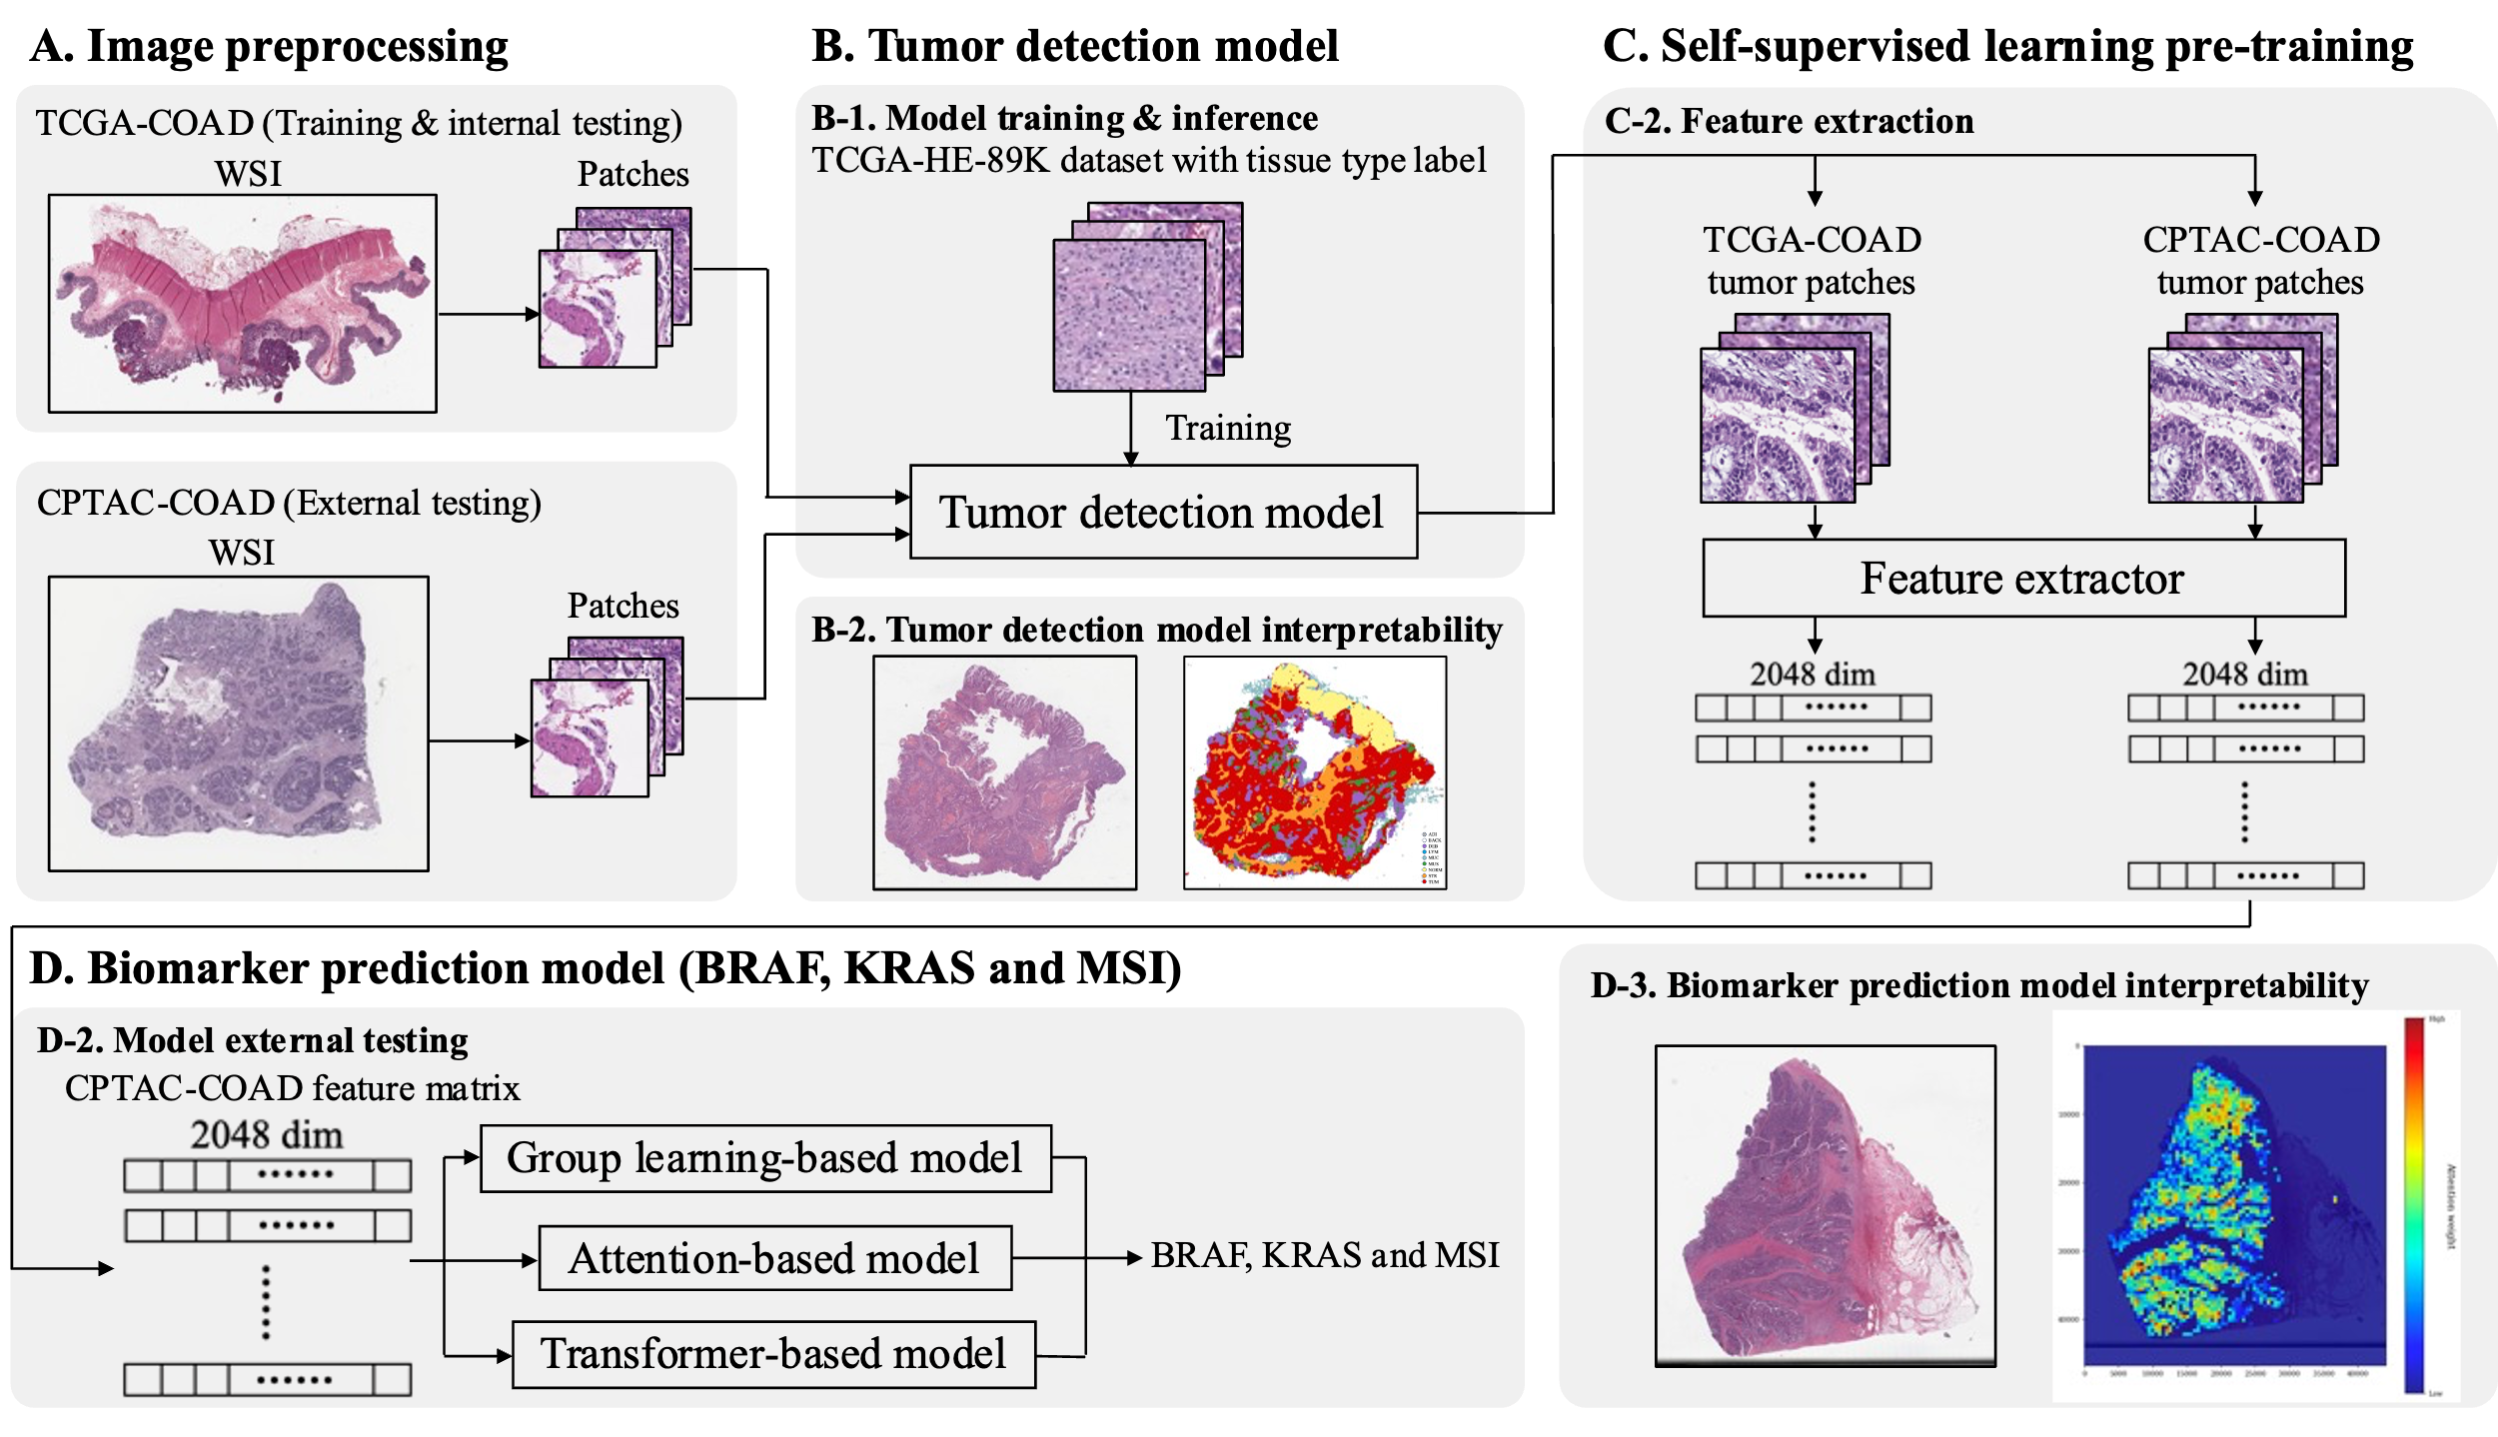

Slide 5
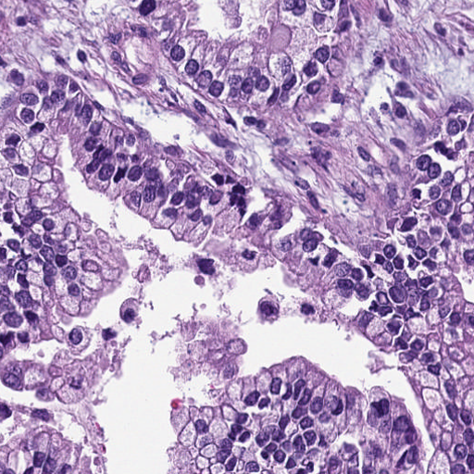
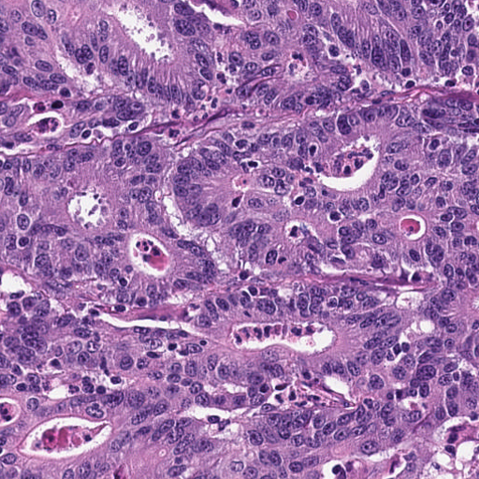
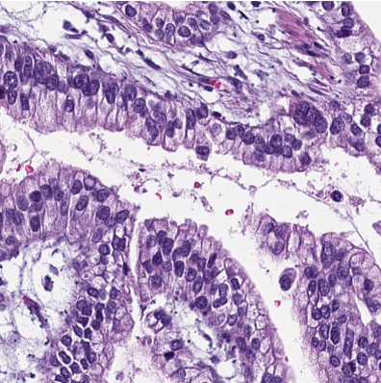
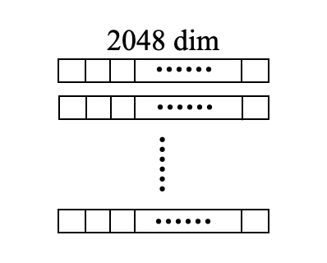
Why choose group learning?
1
This research can be simplified into multiple instance learning question. For most of the literature that deal with this problem, it focus on how to design pooling method to fix the input size
2
In our research, we have already used MIL attention pooling mechanism and self attention pooling mechanism. For third biomarker prediction model, I think we can try in different aspect.
TCGA-COAD tumor patches
CNN
Patch-level prediction
Slide-level prediction
TCGA-COAD tumor features
MLP
Patch-level prediction
Slide-level prediction

Slide 6
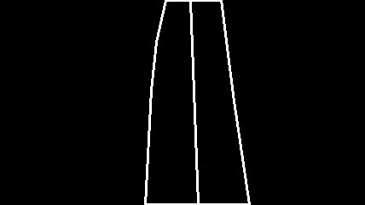
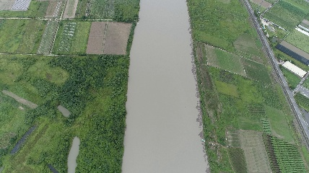

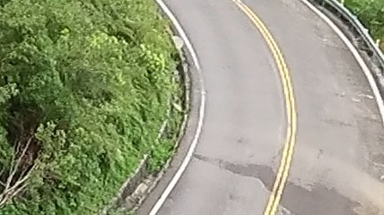
Generative AI competition
Aim: use Generative AI to generate drone aerial image from image contour label
River
Road

Slide 7
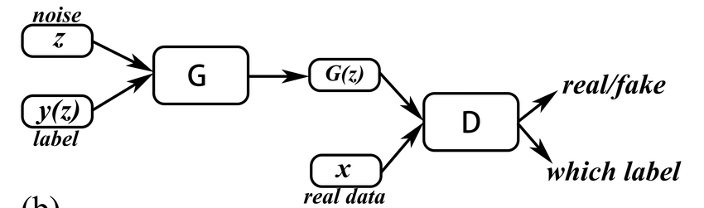
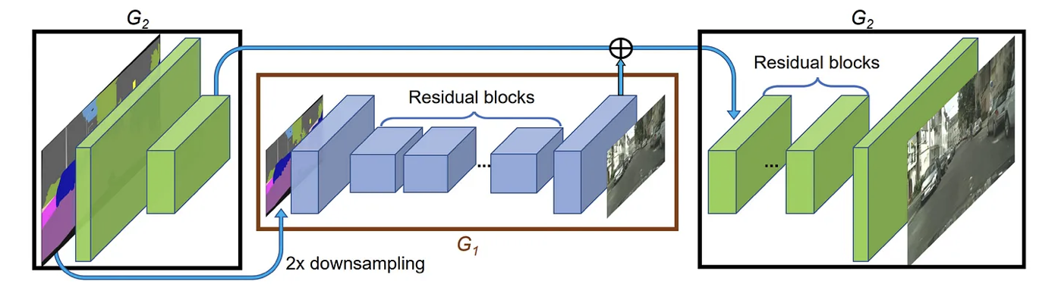
Generative AI competition
Method: pix2pix
Literature reference: Wang, Ting-Chun, et al. "High-resolution image synthesis and semantic manipulation with conditional gans." Proceedings of the IEEE conference on computer vision and pattern recognition. 2018.
Conditional GAN: cGAN is a variant of the GAN that incorporates conditional information into the model. There are two model which is generator and discriminator, trained simultaneously through a process where the generator tries to create realistic data instances while the discriminator tries to distinguish between real and generated instances.

Slide 8
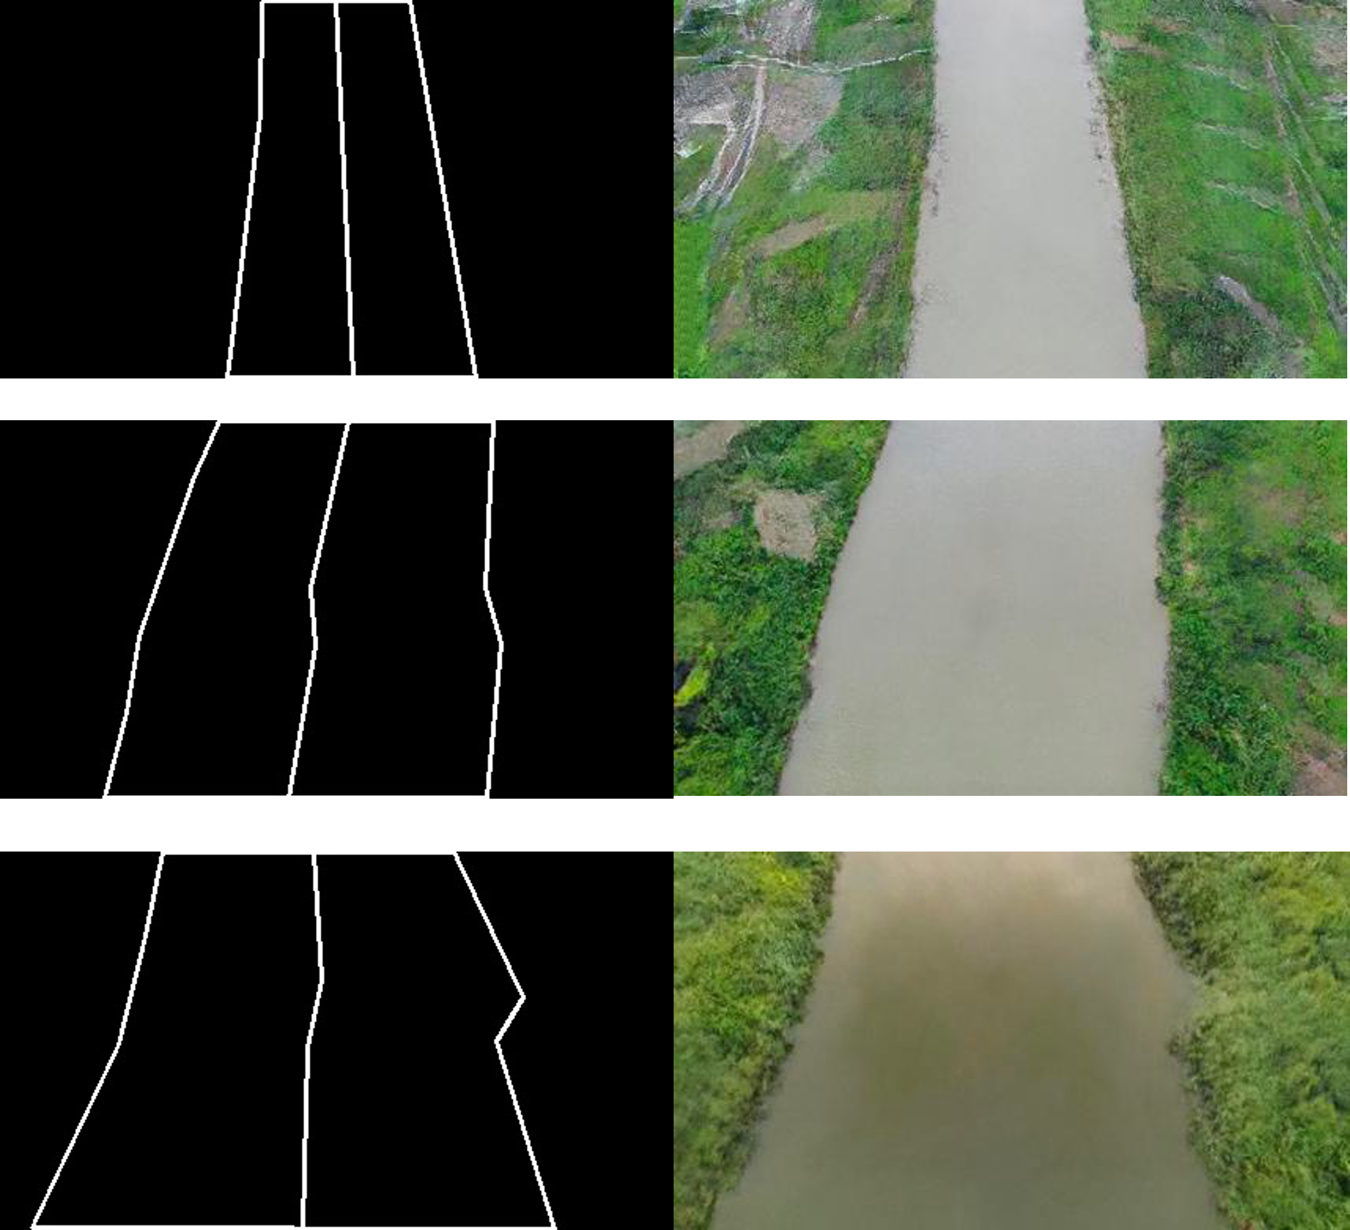
Generative AI competition
RIVER

Slide 9
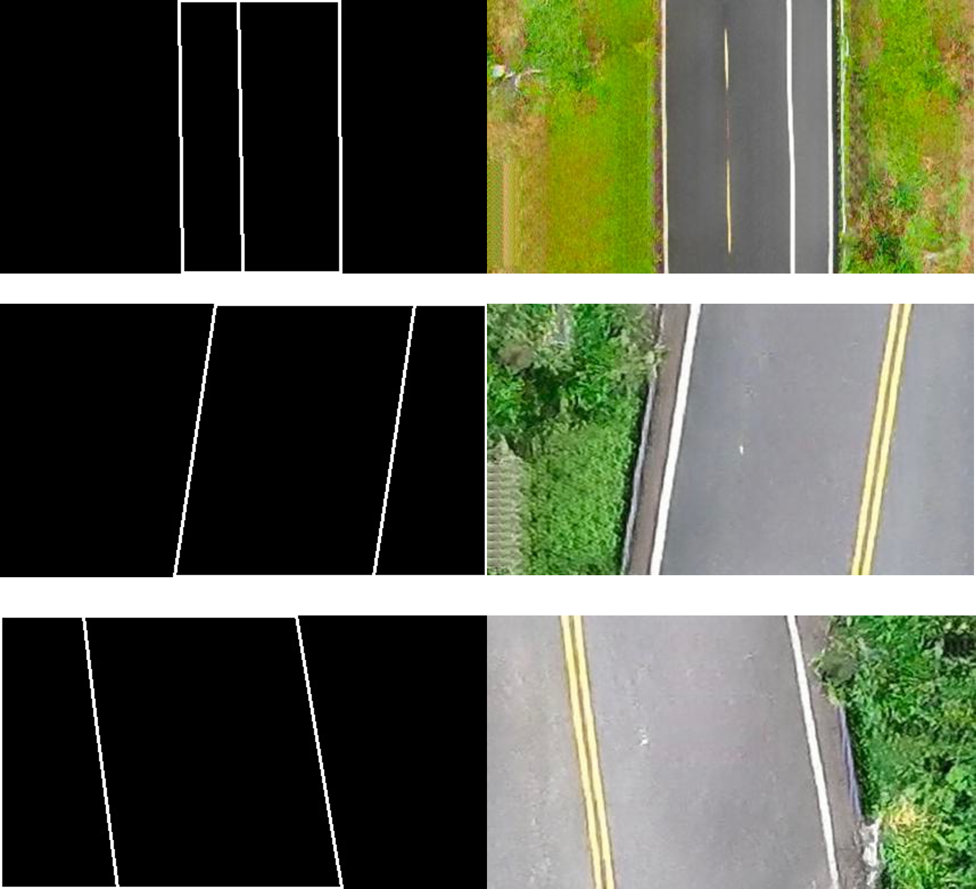
Generative AI competition
ROAD

Slide 10
Future works
1
Finish group learning of biomarker prediction

